Slide 1
Practical web development basics
HTML
CSS
PHP
REST
javascript
Node
Angular
ORM
?!
Prepared by Nitish Patkar

Slide 2
Important milestones in the history of web development
1993
HTML
1995
Javascript
1996
CSS & Flash
2005
Ajax
2006
jQuery & Amazon Web Services
2010
AngularJs
2011
Bootstrap
2013
React
2016
Angular 2+

Slide 3


As a web developer you cannot live without..

Slide 4
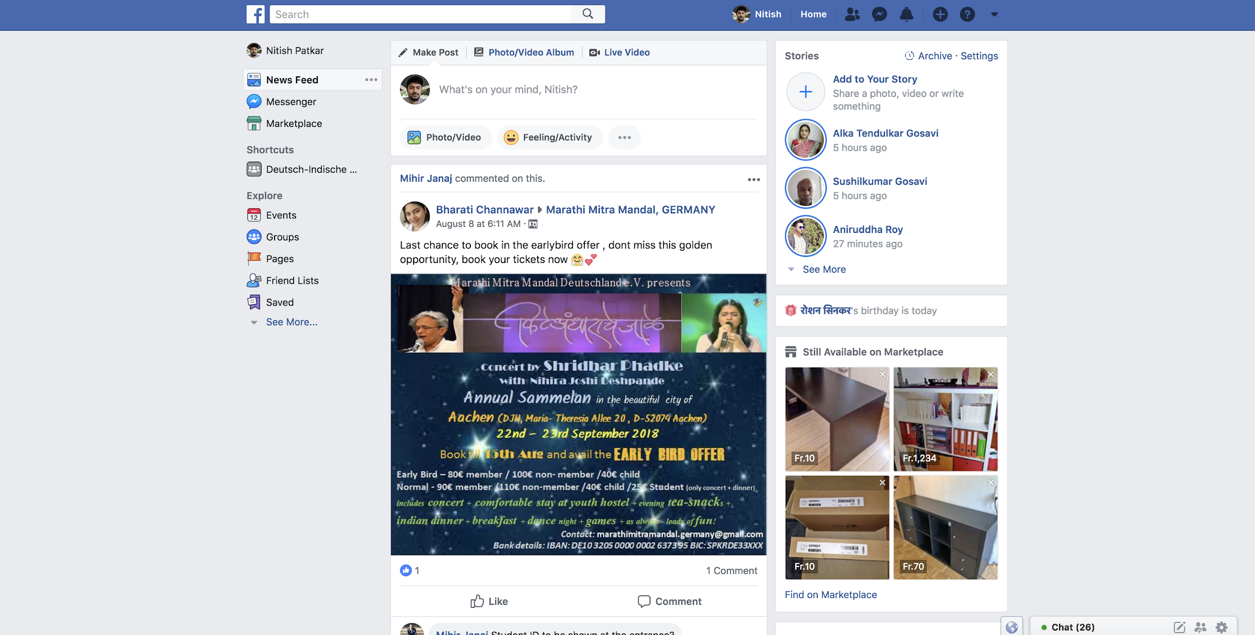
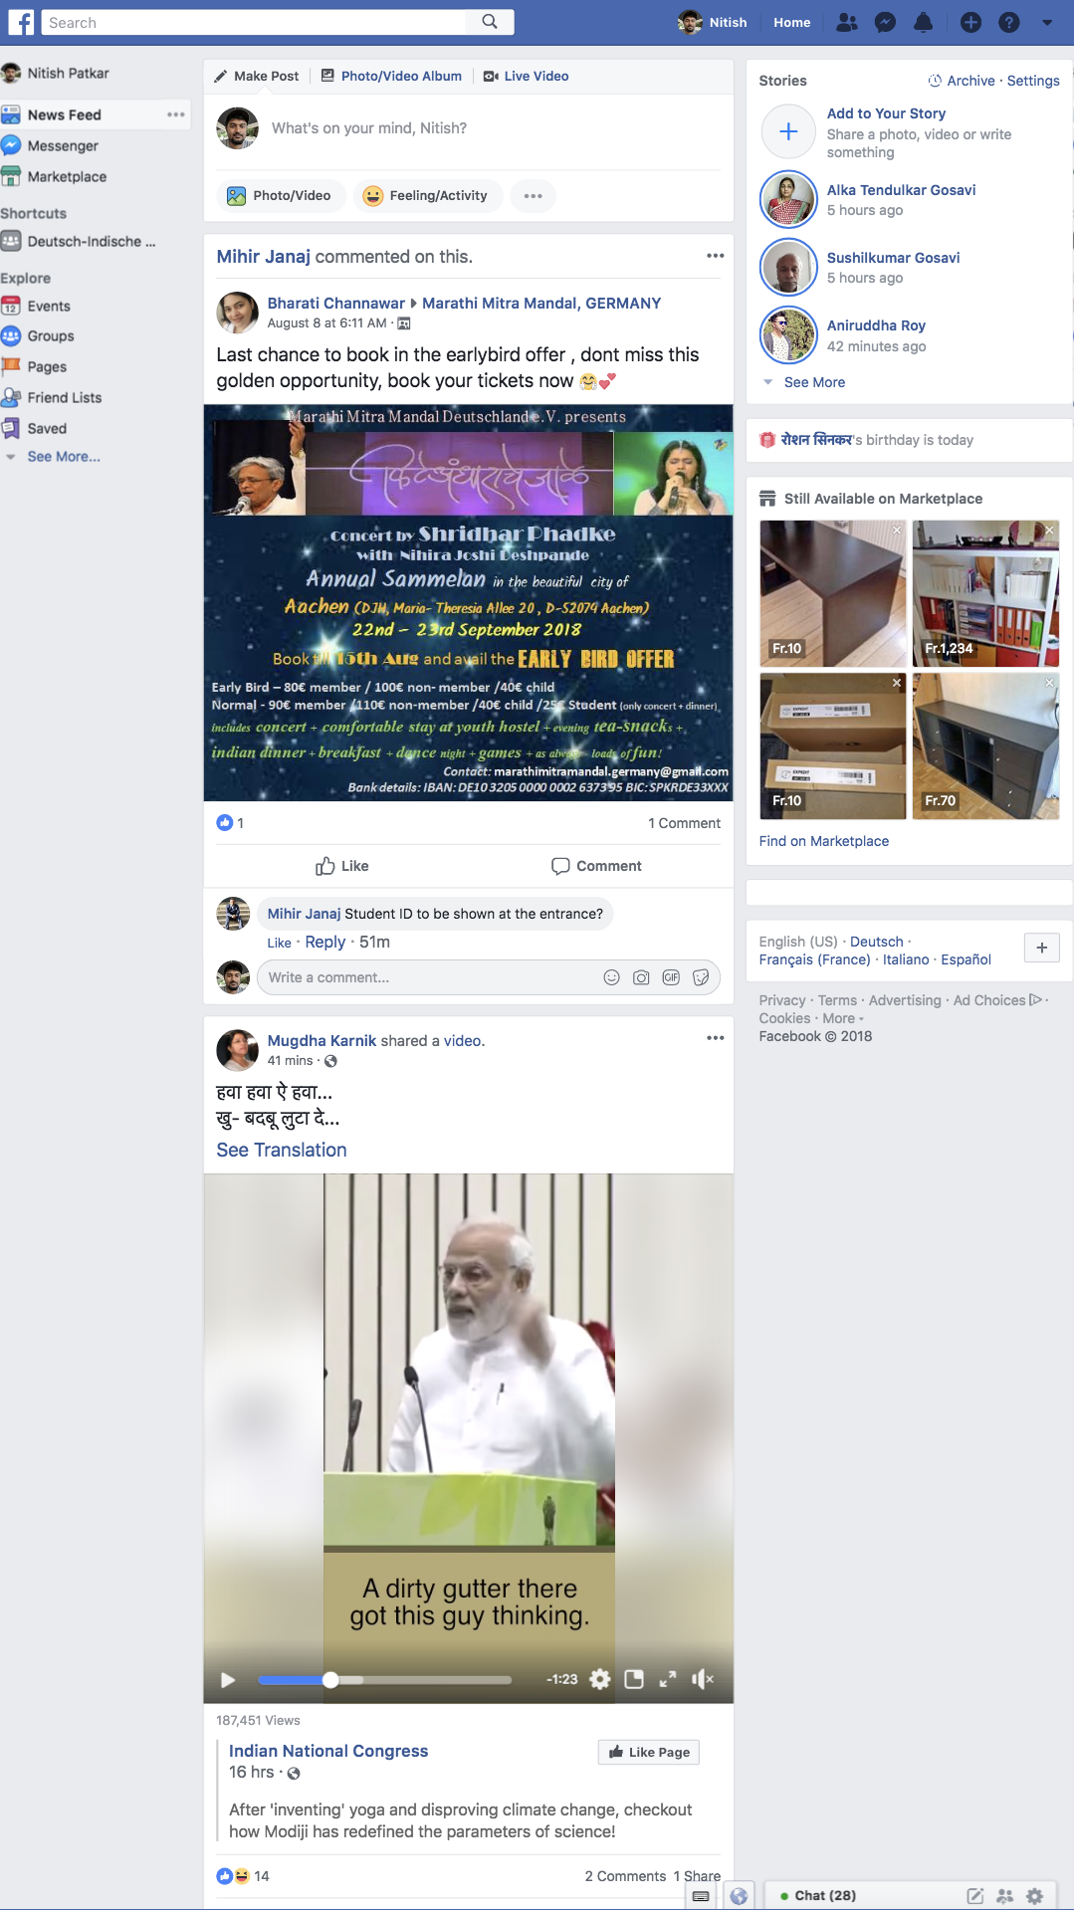
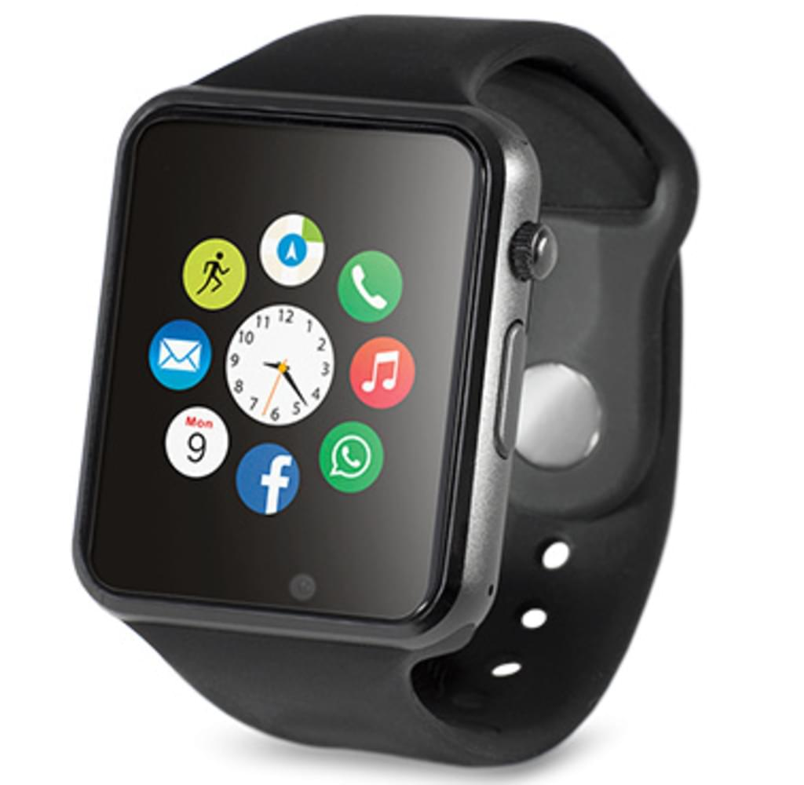
Simplified view on today's web development
HTTP request
backend
REST
API
ORM
HTTP response
Database
Various frontends

Slide 5
Frontend: key responsibilities and main concepts
It is what your users see- can be accessed on mobile as an app, or as a mobile website, or on laptops etc.
Accepts request from users and forwards it to the backend, subsequently receives response from backend and shows it to the user
Main concepts to get familiar with-
HTML, CSS, Javascript, Typescript
HTTP requests
Ajax (or asynchronous calls to backend)
Javascript frameworks and libraries (e.g. Angular, React, Vue.js )
Styling frameworks (e.g. Bootstrap, Material)
Package manager (e.g. NPM)
Single Page Applications (SPAs)
Developer tool in browser for debugging
Responsive design
Browser compatibility
...
Various frontends

Slide 6
Frontend: key responsibilities and main concepts
It is what your users see- can be accessed on mobile as an app, or as a mobile website, or on laptops etc.
Accepts request from users and forwards it to the backend, subsequently receives response from backend and shows it to the user
Main concepts to get familiar with-
HTML, CSS, Javascript, Typescript
HTTP requests
Ajax (or asynchronous calls to backend)
Javascript frameworks and libraries (e.g. Angular, React, Vue.js )
Styling frameworks (e.g. Bootstrap, Material)
Package manager (e.g. NPM)
Single Page Applications (SPAs)
Developer tool in browser for debugging
Responsive design
Browser compatibility
...
Various frontends

Slide 7
Backend: key responsibilities and main concepts
Handles business logic for your application- you write a single backend application which is typically consumed by various frontends
Coordinates with frontend and database
Main concepts to get familiar with-
REST API
JSON data format
Programming languages (e.g. PHP, Python, Java)
Backend frameworks (e.g. Django Rest, .NET core, Ruby on Rails, Express)
Object Relational Mapping (ORM)
Request routing
Security concerns
Architecture (e.g. MVC, MVVM)
Session management
...
backend
REST
API
ORM

Slide 8
Backend: key responsibilities and main concepts
Handles business logic for your application- you write a single backend application which is typically consumed by various frontends
Coordinates with frontend and database
Main concepts to get familiar with-
REST API
JSON data format
Programming languages (e.g. PHP, Python, Java, Javascript)
Backend frameworks (e.g. Django Rest, .NET core, Ruby on Rails, Express)
Object Relational Mapping (ORM)
Request routing
Security concerns
Architecture (e.g. MVC, MVVM)
Session management
...
backend
REST
API
ORM

Slide 9
Database: key responsibilities and main concepts
Stores user and application data
With the availability of ORMs, developers deal less and less with databases directly, but it is still good to know
Main concepts to get familiar with-
Types of databases (e.g. Relational, non-relational)
Database backups
Database query languages (e.g. SQL)
Scripting languages (e.g. PL/SQL)
...
Database

Slide 10
Database: key responsibilities and main concepts
Stores user and application data
With the availability of ORMs, developers deal less and less with databases directly, but it is still good to know
Main concepts to get familiar with-
Types of databases (e.g. Relational, non-relational)
Database venders (e.g. MySQL, PostgreSQL, MongoDB)
Database backups
Database query languages (e.g. SQL)
Scripting languages (e.g. PL/SQL)
...
Database

Slide 11
Frameworks
One can do web development without frameworks, but using them simplifies many routine tasks and speeds up the development, also makes sure applications are scalable
Choosing a correct framework depends on multiple factors such as programming language preference, framework documentation, community support etc.
There are different frameworks for frontend development, backend development, and also for styling

Slide 12
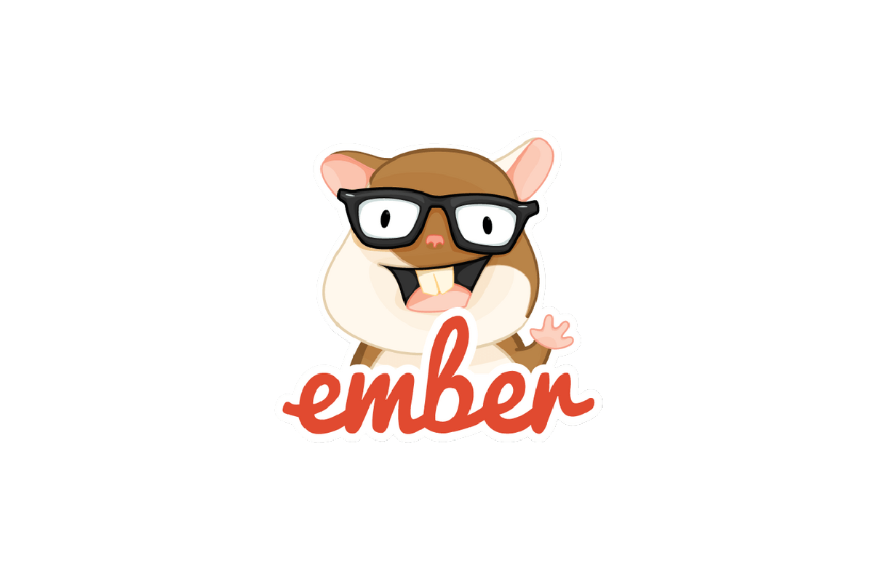
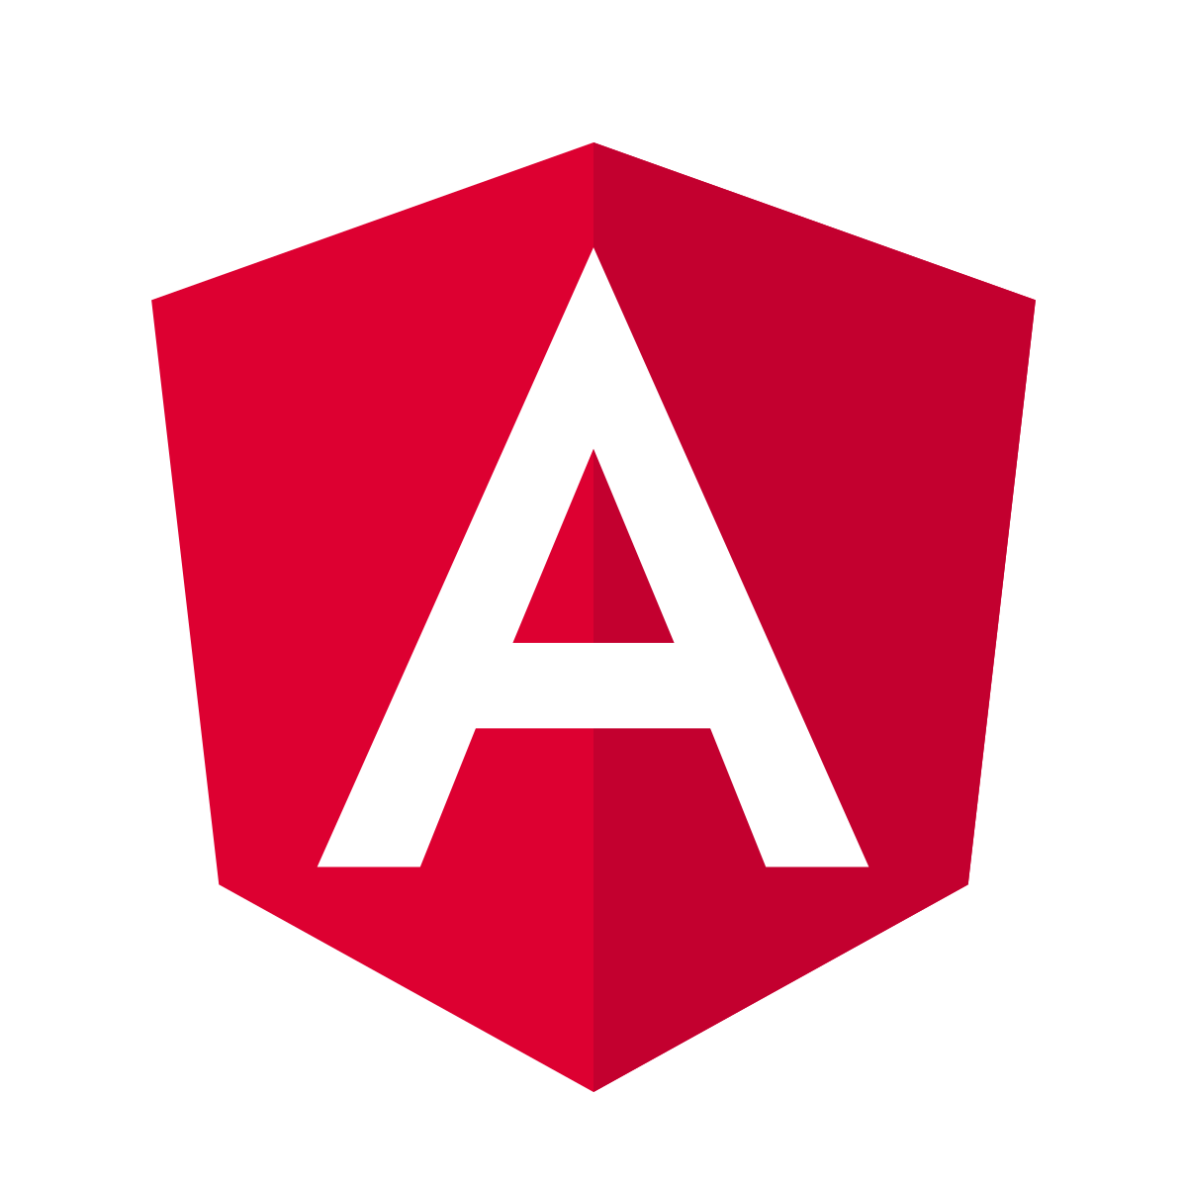


Frontend (javascript) frameworks
Enforces developers to write HTML, CSS and javascripts in a certain way to make the application easier to develop and maintain
Easy handling of Ajax calls, HTTP requests
Most popular frontend frameworks and libraries:
Angular
Vue.js
React
Ember.js

Slide 13

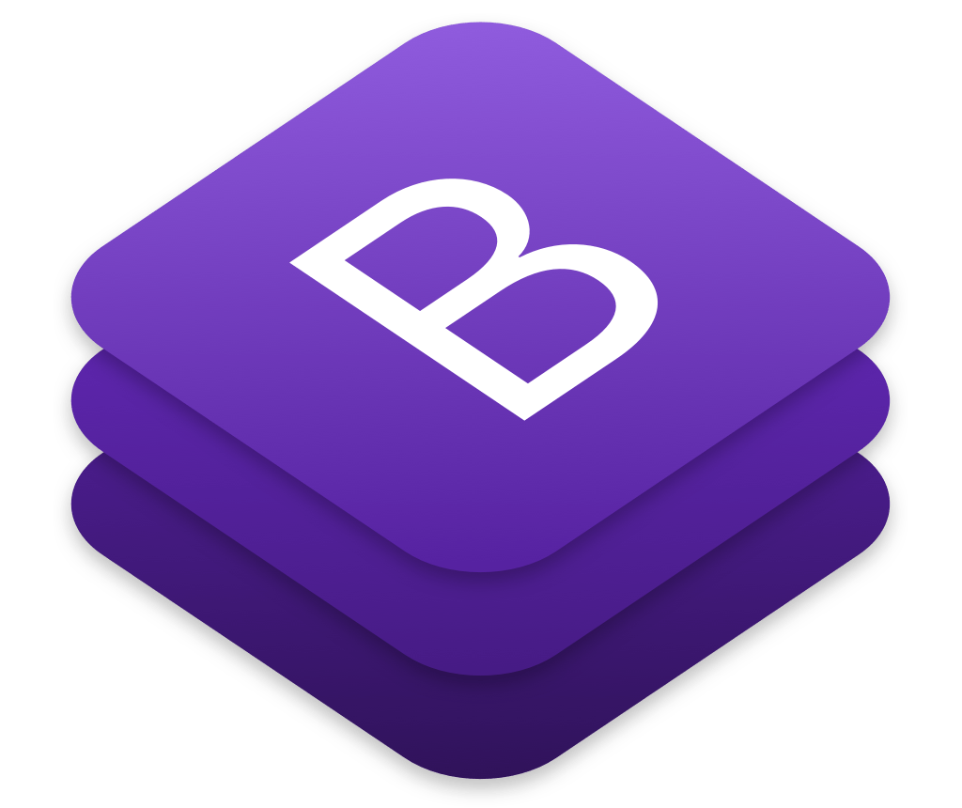


Styling (CSS) frameworks
Provides ready to use css classes, components and grid system based on proven design standards, so that developers do not have to write css from scratch
Most popular css frameworks:
Bootstrap
Semantic UI
Materialize
Material UI

Slide 14


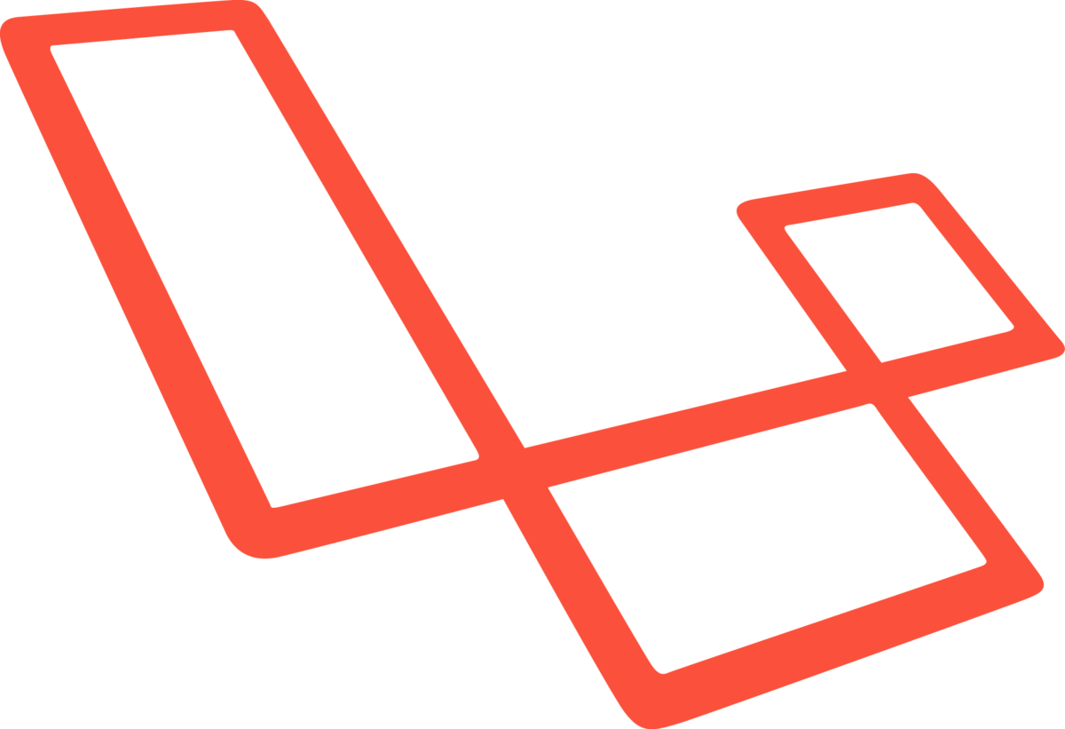

Backend frameworks
They provide tools and libraries that simplify common web development tasks, including routing URLs to appropriate handlers, interacting with databases through ORM, supporting sessions and user authorization, formatting output (e.g. HTML, JSON, XML), and improving security against web attacks.
Most popular backend frameworks:
Ruby on Rails
Laravel
Flask

Slide 15
 | Frontend | Backend
Concepts to get familiar with | HTTP requests, responsive design, asynchronous calls, SPAs, NPM,... | HTTP requests routing, REST API, ORM, token & session management, CSRF, ...
Languages used | HTML, CSS, Javascript, Typescript | Python, Java, javascript,...
Popular frameworks | Angular, React, Vue.js,.. | Django, .NET core, Laravel, Express,...
Popular styling frameworks | Bootstrap, Material UI, Saas,... | -

Slide 16
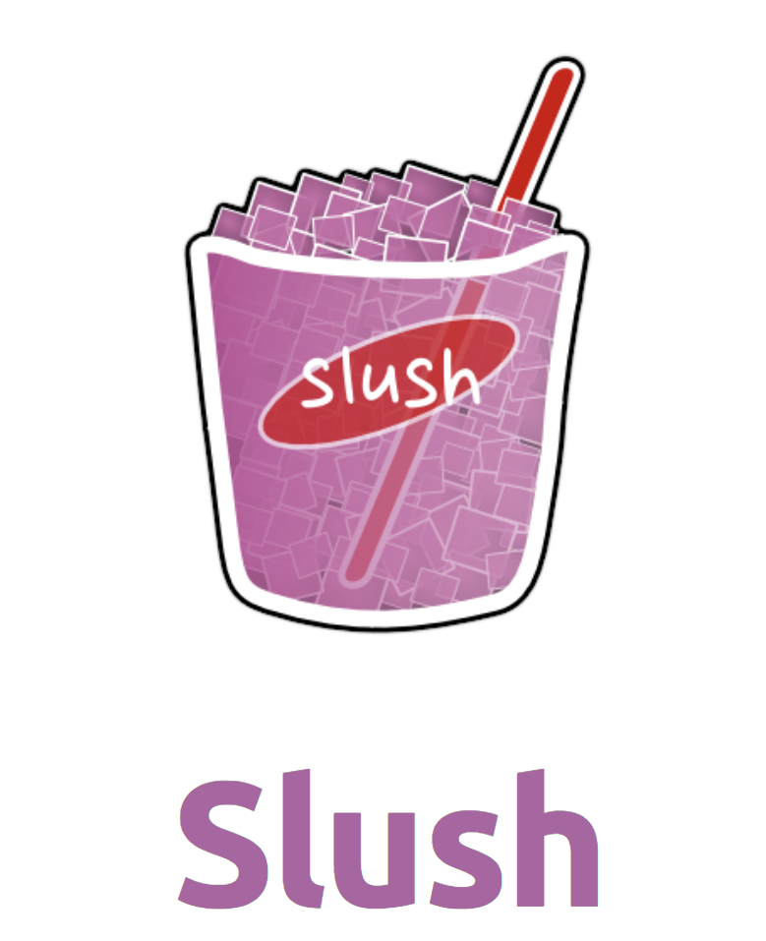

Project scaffolding
Helps to quickly set up a project skeleton (hopefully) with best practices
One can scaffold a project by using CLI tools such as angular cli for angular projects, or by cloning a repository from github, gitlab etc.
Best known scaffolding tools:
Yeoman

Slide 17



Project management tools
Helps to organize development work within teams, manage user stories, deadlines, generate project analytics and many more tasks
Best known project management tools:

Slide 18

Communication tools
Helps to communicate with other team members through dedicated channels, direct messages and rich content such as video, images, Gif etc.
Provide search functionality and integrations to other applications such as confluence, gitlab etc.
Best known communication tool:

Slide 19
Latest buzzwords in web development
Agile
CI (Continuous integration)/CD(Continuous delivery) pipeline
DevOps

Slide 20
Latest buzzwords in web development
Useful to know for our project
Agile
CI (Continuous integration)/CD(Continuous delivery) pipeline
DevOps
Agile
CI (Continuous integration)/CD(Continuous delivery) pipeline

Slide 21
Agile
Customer requirements change and developers must react to changing requirements as fast as possible, also make those changes available to the customer as soon as possible
Agile methodology like Scrum enables faster feedback and development loops
Customer representative works closely with the development team which includes Product owner (PO), Scrum master and developers
Each role i.e. PO has defined tasks
Product is built in increments, each development iteration is called Sprint. At the end of each Sprint, a retrospection is conducted to evaluate team's performance.
Team also maintains a product and sprint backlog that contains work to be done in the form of user stories, feature requests, bugs etc.

Slide 22
CI/CD pipeline
Continuous Delivery (CD) is a software strategy that enables organizations to deliver new features to users as fast and efficiently as possible
The pipeline breaks down the software delivery process into stages. Each stage is aimed at verifying the quality of new features from a different angle
There is no standard pipeline however a typical process will look like following:
A pipeline procedure is triggered when code is committed to a repo hosted somewhere like GitHub. Next comes notification to a build system, such as Jenkins. The build system compiles the code and runs unit tests. If your pipeline is built well, and unit tests go smoothly, at this point integration tests are executed. After integration testing is done, you can create images and push them to a registry service, such as Docker Hub. From there, they can be easily deployed on cloud services such as AWS or Google cloud.
References: 1. https://devops.com/continuous-delivery-pipeline/ 2. https://codefresh.io/continuous-integration/continuous-integration-delivery-pipeline-important/

Slide 23

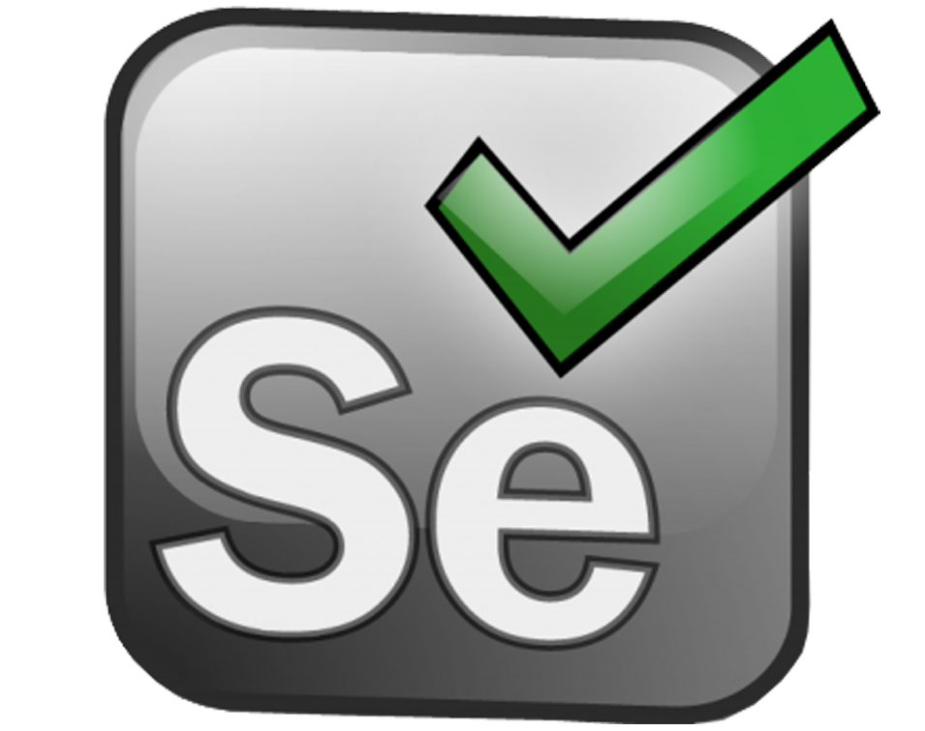
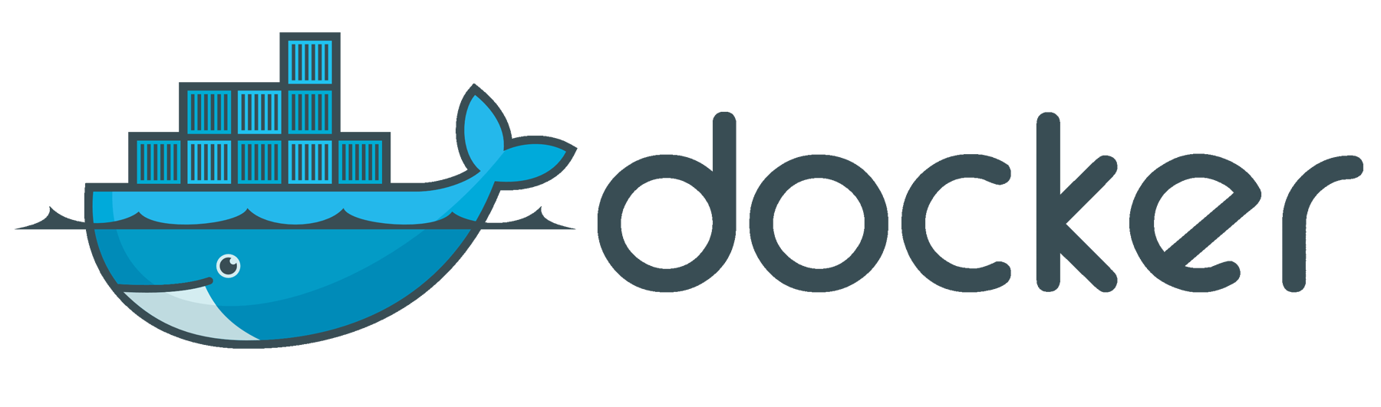


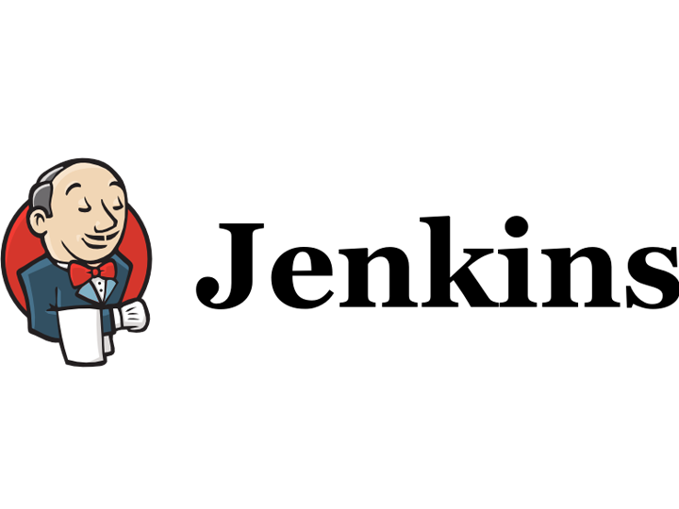

Example CI/CD pipeline and corresponding toolchain
Other end to end solutions
Plan
Code
Build
Test
Release
Deploy

Slide 24
Workflows with Gitlab

